Slide 1
Graduate Labour Economics:
Job search and matching
Neil Rankin
Economics Department, Stellenbosch University
August 2017

Slide 2
Job search and matching
Point of allocation – intercept between vacancies and job-seekers
A match between an employee and an employer is the outcome of two processes:
Job search process by the individual
Recruitment process by the firm
These have a dynamic aspect – individuals, particularly if unemployed, will be continuously making job search decisions
Can have distributional and income effects
Glitches in process can lead to unemployment

Slide 3
An empirical puzzle
One puzzle in the empirical labour research is why observably identical individuals earn such as wide range of incomes
Models with a perfectly competitive labour market cannot explain this
Search and matching models which introduce market frictions, including frictions in information flows, may help explain this.

Slide 4
An empirical puzzle: Africans, 22-26, matric without endorsement
Monthly earnings
Mean R3,375
Median R2,404
25th percentile R1,500
75th percentile R3,800

Slide 5
Outline of this lecture
Characteristics of search and matching models
The broader challenge
A South African example
Thinking about SA unemployment policy challenges through these types of models
Readings:
GORTER, C., NIJKAMP, P. and RIETVELD, P., 1993. The impact of employers' recruitment behaviour on the allocation of vacant jobs to unemployed job seekers. Empirical Economics, 18(2), pp. 251-269.
MORTENSEN, D.T. and PISSARIDES, C.A., 1999. New developments in models of search in the labor market. Handbook of labor economics, 3, pp. 2567-2627.
SCHÖER, V., RANKIN, N. and ROBERTS, G., 2012. Accessing the first job in a slack labour market: Job matching in South Africa. Journal of International Development,
"The Prize in Economic Sciences 2010 - Advanced Information". Nobelprize.org. Nobel Media AB 2013. Web. 19 Aug 2013. <http://www.nobelprize.org/nobel_prizes/economic-sciences/laureates/2010/advanced.html>

Slide 6
Characteristics of search and matching models
Market frictions:
The costly delay in the process of finding trading partners and determining the terms of trade
Individuals do not know about all the current job openings that are suitable for them
Need to incur costs in applying, and interviewing, for the job
Firms do not know about all the potential candidates who could fill a position
Need to spend time and effort in sorting through applicants
‘Good enough’ matches

Slide 7
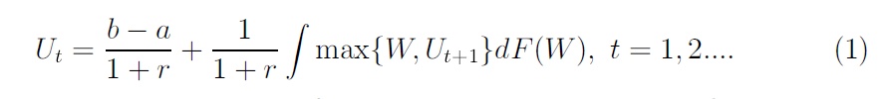
An optimal stopping strategy
Job offers arrive sequentially but once refused are lost
Distribution of potential job offers is usually known but offers appear randomly
The optimal stopping strategy is a dynamic programming problem which consists of comparing the current offer with the expected value of future search
U_{t} is the value of searching in the current period
W is the value of the offered employment (usually the present value of future utility conditional on accepting offer)
r is the discount or risk free rate
b is income flow received contingent on unemployment
a is the cost of search

Slide 8

Two-sided search
Job-worker match occurs when a qualified unemployed worker and a sufficiently attractive vacancy meet
Firms are trading off the forgone profit of the job remaining open versus filling it with the current candidate
V is the value of holding the job vacant
c is the cost of recruitment
η is the frequency with which employers encounter employees
J represents the value of filling the job
G denotes its distribution across workers

Slide 9
A matching function
This describes the relationship between the inputs, search and recruiting activity, and the outputs, the flow rate at which unemployed workers and vacant jobs form job-worker matches
Analogous to a production function and represents the average rate at which unemployed workers and vacancies meet
The matching function: m(v, u), where v is vacancies and u is unemployed workers
λ, η are measures of frequency.

Slide 10
Search and recruitment channels
A further modification in the process is the channels through which individuals search and firms recruit
Individuals choose channels which are open to them but also where they expect to be able to find jobs
Individuals may also choose a channel for its signaling ability
Firms chose channels where the probability of finding good matches is high but need also to consider the cost
Observed matching is an outcome of these various processes
An example: IT professionals on the side of the road

Slide 11
A schematic representation of the process - individuals

Slide 12
A schematic representation of the process - firms

Slide 13
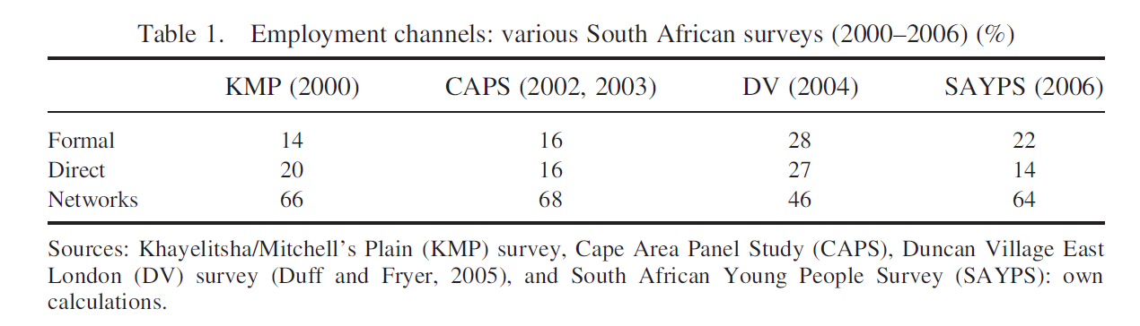
A South African application (Schӧer et al, 2012)
How do South Africans find jobs?
But arrival rates at firms are high.
Median amount reported by firms is 20 individuals per month
Labour market is slack, certainly for the low-skilled, and the employer can pick how and who they employ http://www.fin24.com/Economy/Transnet-job-applicants-hurt-in-stampede-20111007

Slide 14
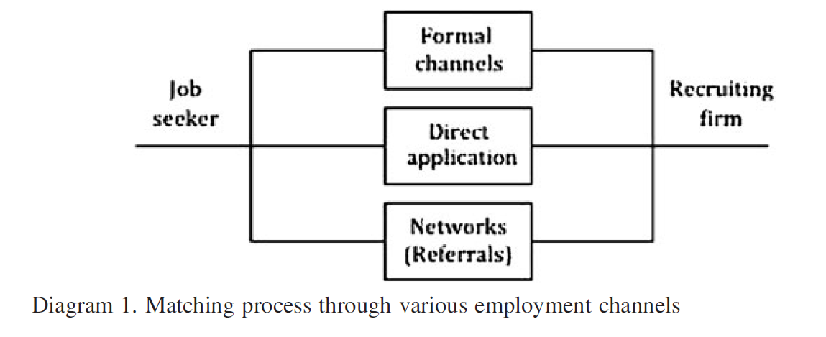
Diagramatically

Slide 15
Optimisation problem
Firms and job seekers face an optimization problem with regards to their choice of their search/recruitment behaviour to overcome two main problems:
information dissemination when locating vacancies/suitable candidates; and
asymmetric information when signalling/evaluating productivity levels.
The ability of the search/recruitment channels to overcome these information problems determines the matching quality
Firms choose recruitment channels which optimise their search for the most suitable candidate based on job characteristics and recruitment cost

Slide 16
Two stage recruitment
Holzer (1987a) argues that the recruitment process contains two stages:
locating a possible candidate and
screening for suitable characteristics.
Recruitment methods need to fulfil both functions.
To overcome the information dissemination problem, firms need to ensure that the pool of applicants contains job seekers with characteristics matching those required for the job. The more complex the required set of characteristics and/or the smaller the existing population of job seekers with the required characteristics, the more likely the firm is to engage in advertising to ensure that at least one applicant exhibits these required characteristics.
To overcome the asymmetric information problem, the employer uses the screening process to establish accurate information about the applicant’s productivity level.

Slide 17
Skills and the recruitment process
For top-level (high skill/productivity) jobs firms are more likely to invest in the recruitment process since:
Match is key
Recruitment cost is small proportion of productivity/wage
For lower-level (low skill/productivity) jobs firms are more likely to pursue recruitment methods which still produce relatively reliable information about the applicant’s productivity levels but at the least possible cost, such as the use of referrals by their own workforce
Firm characteristics, such as size, are likely to be correlated with the use of channel
Large firms can absorb fixed cost of HR/recruitment and thus use formal channels
Smaller firms may prefer ‘known’ quantities - referrals

Slide 18
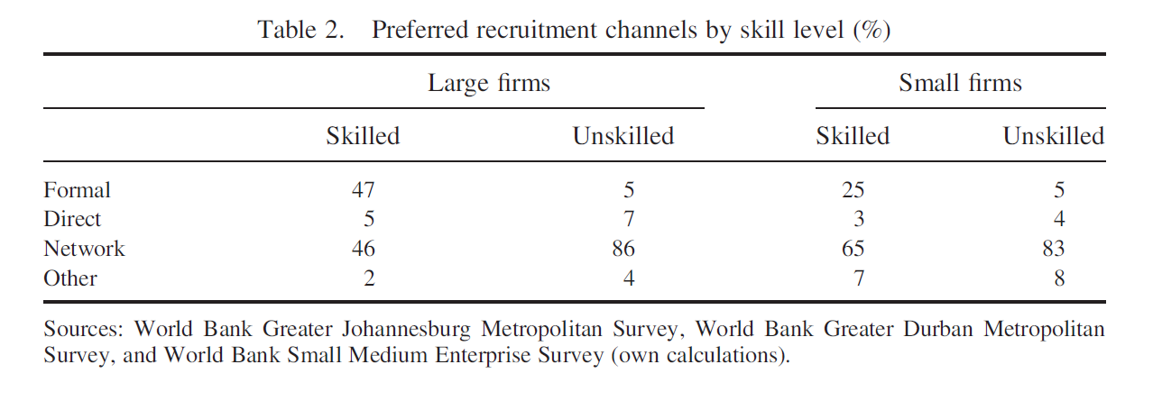
Preferred recruitment channels

Slide 19
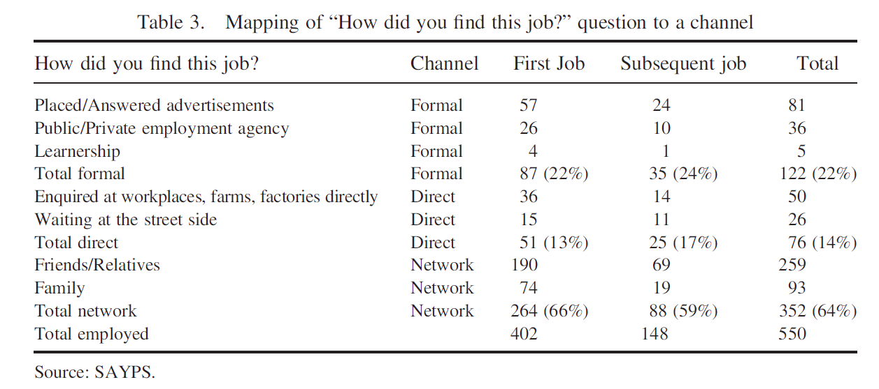
How did you find a job?

Slide 20
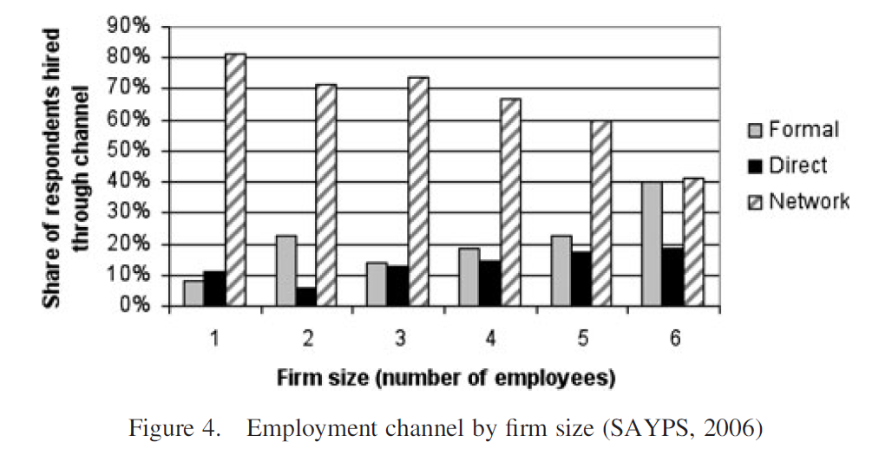
Variation by firm size

Slide 21
Channel of match conditional on job

Slide 22
South African summary
Different sets of individual, household, firm and job characteristics are associated with the probability of accessing the first job through a particular employment channel
Likely to reflect selection by job seekers and recruiting firms into the use of particular search/recruitment channels
Things like gender and the size of firm seem to play a role
Need panel and/or matched employer-employee data to disentangle some of this
Information on job offers would also be helpful

Slide 23
What about reservation wages?
Key point in these models is that there is a reservation wage below which individuals will not accept a job
Relatively little research in South Africa
Does it exist?
How does it work?
Why?
Information flows or desires – Rankin and Roberts (2011), young people give reservation wages for large firms

Slide 24
South African questions
A number of policies have been proposed to improve labour market outcomes for young South Africans. Thinking about them through the lens of search and matching models, what do you think the impact will be?
Rate in order of impact in terms of number of jobs for young people
A job search/transport subsidy
Compulsory listing of vacancies with the Department of Labour’s Labour Centres
A once-off payment to young people who get a job (similar to the Earned Income Tax Credit in US)
A tax incentive to encourage firms to hire young people (the Employment Tax Incentive – ETI)
Providing young people with additional qualifications
Harambee (http://harambee.co.za/harambee/)
The national minimum wage

